Slide 1
CSCE 5520
Wireless Networks and Protocols
RFID and NFC
1

Slide 2
Outline
RFIDs
» Concept and applications
» EPC and backend processing
» PHY and MAC
» Security
Near Field Communication
Battery-less devices
2

Slide 3
What is RFID ?
Radio Frequency IDentification (RFID) is a method of remotely storing and retrieving data using devices called RFID tags and RFID Readers
An enabling technology with many applications
» Data can be stored and retrieved from the tag automatically with a Reader
» Tags can be read in bulk
» Tags can be read without line of sight restrictions
» Tags can be write once read many (WORM) or rewritable
» Tags can require Reader authentication before exchanging data
» Other sensors can be combined with RFID
Technology has been around for a long time
Also has critics, e.g. privacy concerns
3

Slide 4
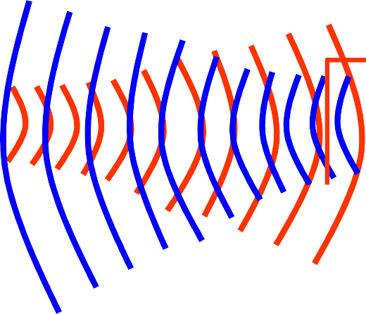
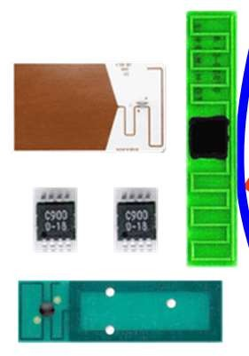
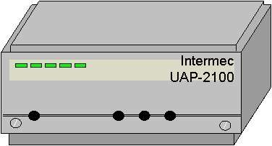
How Does It Work?
Intermec UAP-2100
What is RFID?
A means of identifying a unique object or person using a radio frequency transmission
Tags (or transponders) store information, that can be retrieved wirelessly in an automated fashion
Readers (or interrogators), either stationary and hand- held, can read/write information from/to the tags
Reader
Tags
How does it operate?
RFID tags are affixed to objects and stored information may be written and rewritten to an embedded chip in the tag
Tags can be read remotely when they receive a radio frequency signal from a reader and use the energy to respond
Can operate over a range of distances
Readers display tag information or send it over the network to back-end systems
4

Slide 5
Applications
Operational Efficiencies
» Shipping and Receiving
» Warehouse management
» Distribution
» Asset management
Total Supply Chain Visibility
» Inventory visibility in warehouses
» In-transit visibility, asset tracking
» Pallet, case level
» Item, instance level
Shrinkage, counterfeit
» Reduce internal theft
» Reduce process errors
» Avoid defensive merchandizing
» Product verification
» Origin, transit verification
Security, Regulations
» Total asset tracking
» Defense supplies
» Container tampering
» Animal Tracking
5

Slide 6

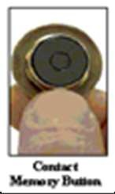

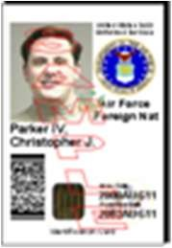
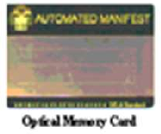
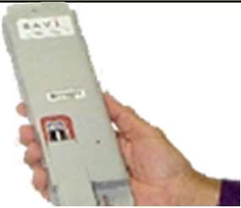
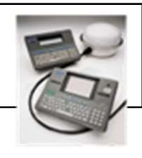
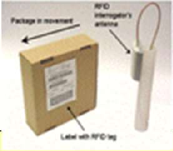
Automated Identification Technology Suite
CMB
Contact Memory Button
Linear Bar Code
2D Symbol
QR Code
Smart Card/CAC
OMC
Optical Memory Card
RFID - Active Radio Frequency ID
STS
Satellite-Tracking Systems
RFID- Passive Radio Frequency ID
6

Slide 7
RF ID Types
Passive Tags: rely on an external energy source to transmit
» In the form of a reader that transmits energy
» Relative short range
» Very cheap
Active Tags: have a battery to transmit
» Has longer transmission range
» Can initiate transmissions and transmit more information
» A bit more like a sensor
Battery Assisted Passive tags are a hybrid
» Have a battery transmit
» But need to be woken up by an external source
10

Slide 8
A Bit of History
Early technology was developed in the 40s
» Originally used as eaves dropping devices
» Used reflected power to transmit (transponder), e.g. the membrane of a microphone
First RF IDs were developed in the 70s
» Transmission based on reflected energy using information in memory – readers can now distinguish devices
Dramatic growth since then driven by industry
» Potential for significant gains in areas
» Big organizations (DOD, Walmart) requiring the use of RFIDs from their vendors for easy inventory control
Set of applications expanded rapidly
11

Slide 9
Standards
Passive tags operate in the LF, HF, and UHF unlicensed spectrum
30-300 KHz, 3-30 MHz, 300-3000 MHz
Distance drop with frequency
Transmission consists of a bit stream and CRC
Many standards exist, mostly incompatible
» Early standards mostly defined by the ISO
» Widely used standard: ISO/IEC14443
In 2003 EPCGlobal was formed to promote RFID standards
» Defined a standard for the Electronic Product Code (EPC)
» Also defined standards for coding and modulation

Slide 10
Primary Application Types
Identification and Localization
Readers monitoring entering and exiting a closed region
» Security (RFID in identification cards)
» Merchandise in stores
» NFC in phones
Readers tracking an RFID-tagged object
» Business process monitoring (RFID tags on pallets)
Tags marking a spatial location
» An NFC enabled mobile phone passes tags in the infrastructure whose location is known

Slide 11
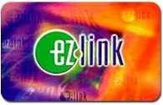
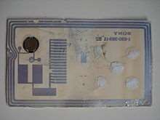
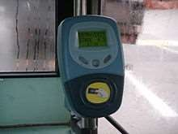
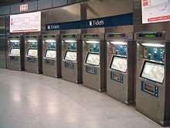
Example: Smart Card
Public transport system in Singapore
FeliCa Smart Card
2001 – 2009
Faster boarding times
Other uses
small payments retail
identification
Replaced by contactless card (RFID)

Slide 12

How Smart are RFIDs?
Basic tags simply reply with a fixed bit string – “read” the tag
» “I am Groot”
» Already useful!
Gradual move to richer functionality
» Changing the state on the tag – “write”
E.g., keep track of a balance
» Privacy and security: encryption, access control, …
E.g., different parties and read and write the tag
» Add computing capabilities (more general than crypto)
Next step is processors that operate entirely based on harvested ambient energy
» Vibrations, RF, solar, …

Slide 13
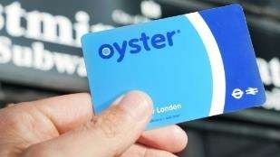
Example “Oyster” Card
Balance is maintained on the card
» Cryptographically secured
The “reader” updates the
balance as you enter/leave the metro station
» Enter: record when and where you boarded
» Leave: update balance on the card
» These operations are local
Readers record all trips and periodically send information to servers
» Auditing trail, lost cards, etc.
» Riders can check their balance online

Slide 14
Outline
RFIDs
» Concept and applications
» EPC and backend processing
» PHY and MAC
» Security
Near Field Communication
Battery-less devices

Slide 15
Electronic Product Code (EPC)
"A Universal identifier for physical objects"
» Designed to be unique across all physical objects in the world, over all time, and across all categories of objects.
» Intended for use by business applications that need to track all diverse physical objects, whatever they may be.
» urn:epc:id:sgtin:0614141.012345.6285210cc Syringe #62852 (trade item)
Combined multiple components
» EPC data located on the RFID tag
» Reader’s middleware
» Locate EPC Information Services (EPCIS), using Web Services like SOAP and WSDL
Not exciting but standardization is critical to wide-spread adoption

Slide 16






















EPC Network Concept (2001)
external software application PML
DNS
Object Name Service (ONS)
EPC Information Service (EPCIS)
PML
Savant Middleware
PML
reader interface protocol & PML Core
reader device
RFID protocols UHF Class 0/1 & HF Class 1
RFID transponder

Slide 17
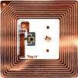
What information does an RFID tag contain?
Gen 2 tags have four memory banks
Bank 0
Reserved Memory
Bank 1
EPC Memory
Bank 2
Tag Identification Memory *
Bank 3
User Memory *
User-defined format
32-bit Kill Password
32-bit Access Password
16-bit CRC
16-bit Protocol Control
96-bit EPC
8-bit Class Identifier
12-bit Tag Designer
12-bit Tag Model Number
32-bit Serial Number (optional)
(0, 32, or 64 bits)
(64 bits)
(128 bits)
(0 or more bits)
The CBP “GDTI-96” bit
unique number
A 64-bit TID memory bank contains a tag serial number that uniquely identifies a tag.
* TID and User Memory banks are not initialized on some Gen 2 tags
Example to illustrate concept
20
Peter A. Steenkiste, CMU

Slide 18
Passive RFID Tags
Power supply
» passive: no on-board power source, transmission power from signal of the interrogating reader
» semi-passive: batteries power the circuitry during interrogation, once woken up by external signal
» active: batteries power transmissions (can initiate communication, ranges of 100m and more, 20$ or more)
Frequencies
» low frequency (LF): 124kHz – 135 kHz, read range ~50cm
» high frequency (HF): 13.56 MHz, read range ~1m
» ultra high-frequency (UHF): 860 MHz – 960 MHz (some also in 2.45GHz), range > 10m

Slide 19
Frequency Bands Passive RFID Tags
Electromagnetic Spectrum
Electric | Radio | Infra-red | Visible | Ultra- | X-Rays | Gamma | Cosmic
Waves | Waves |  | Light | Violet |  | Rays | Rays
Radio Spectrum
9kHz
30kHz
300kHz
3000kHz
30MHz
300MHz
3000MHz
30GHz
300GHz
3000GHz
VLF
LF
MF
HF
VHF
UHF
SHF
EHF
No desigt nated
Lon Wg av e
Mediu mWav e
Shor Wt av e
VLF LF MF HF
The “RFID”
Frequencies
Very Low Frequency Low Frequency Medium Frequency High Frequency
VHF UHF SHF EHF
Very High Frequency Ultra High Frequency Super High Frequency
Extremely High Frequency
125-134 kHz
13,56 Mhz
860-930
MHz
2,45 and 5,8 GHz

Slide 20
Standards
ISO 18000: multipart standard for protocols in LF, HF, and UHF bands
For example, HF:
» ISO 14443 (A and B) for "proximity" RFID
» ISO 15693 for "vicinity" RFID (basis for ISO 18000 part 3)
Two classes:
» Class 0: read only
» Class 1: read/write, can for example be used for tracking
Many more standards exist!

Slide 21
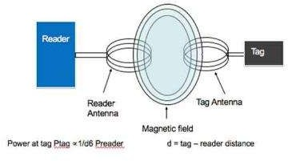
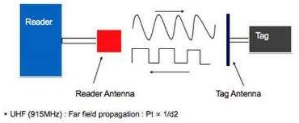
Transmission methods
LF and HF: inductive coupling
» Coil in the reader antenna and a coil in the tag antenna form an electromagnetic field
» Tag changes the electric load on the antenna.
UHF: propagation coupling: backscatter
» Tag gathers energy from the reader antenna
» Microchip uses the energy to change the load on the antenna and reflect back an altered signal
» Different modulations used by reader and tag
From: http://www.highfrequencyelectronics.com/Archives/Aug05/HFE0805_RFIDTutorial.pdf
Peter A. Steenkiste, CMU https://rfid4u.com/rfid-basics-resources/inductive-and-backscatter-coupling/
24

Slide 22
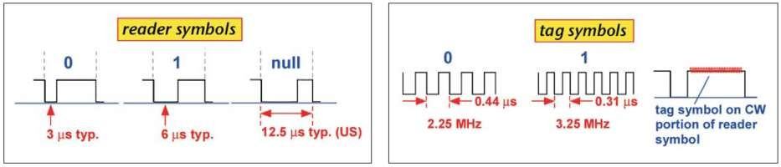
PHY Layer
Depends on the frequency band used
Different modulations used by reader and tag
» Different constraints, e.g. power and complexity
» E.g. cannot used amplitude modulation for HF tag (why?)
Example of EPCGlobal symbols for UHF
From: http://www.highfrequencyelectronics.com/Archives/Aug05/HFE0805_RFIDTutorial.pdf
25
Peter A. Steenkiste, CMU

Slide 23
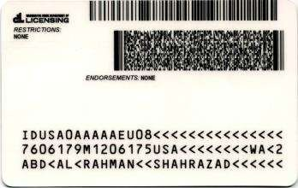
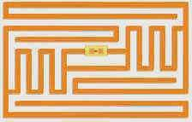
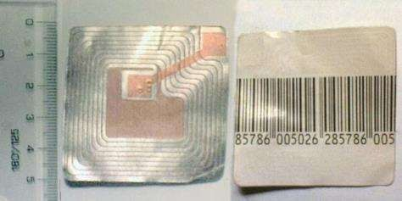
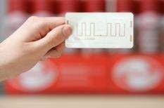
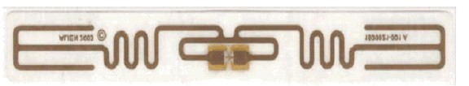
What does an RFID tag look like inside a card?

Slide 24
MAC Layer
Typically assumed that only one reader is present, i.e. no need for MAC on the reader
MAC for tags is a challenge: very high concentrations of tags are present in many contexts
» And tags are dumb, i.e. cannot have sophisticated protocols (carrier sense, RTS/CTS, ..)
» Must also deal with multiple readers operating in the same environment
Two types of schemes used (standard):
» Binary tree resolution: reader explores a tree of relevant tag values
» Aloha: tags transmit with a random backoff

Slide 25
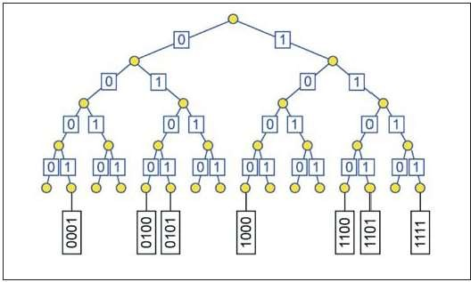
Binary Tree Resolution
Send requests to tags with ids that start with a certain string
Narrow down search until one tag responds

Slide 26
General Security Concerns
RFID tags raise a number of security concerns:
» Privacy risks, e.g., eavesdropping
» Cloning and forging of tags
Specific disadvantages due to tag limitations
» Some encryption algorithms may be too complex to be implemented on tags
But also specific advantages:
» Tags are slow to respond, maximum no. of read-out operations
» Short transmission range means that an adversary has to be physically close

Slide 27
Privacy Concerns
Tracking
» Depends only on unique id (even if random)
» Today:
automated toll- payment transponders
loyalty cards
» Future: pervasive availability of readers
Inventorying
» Invisible items become visible
» Libraries
» Passports
» Human implants: VeriChip
Medical record indexing
Physical access control
30

Slide 28
Privacy for Business Networks
Major concern for industry:
» Supply chain visibility
» Supply chains and business networks are business assets
Example provenance checking: competitors may be able to get a lot of information
» Depending on how detailed the information associated is:
Where an object and its parts where manufactured
When it was manufactured
By which sub-contractors
» Who are the suppliers of a company
» Which companies are the customers of a company

Slide 29
Reading Ranges
Controlling reading range can limit privacy risk
Nominal read range (RFID standards and product specifications):
» 10cm for contactless smartcards (ISO 14443)
Rogue scanning range: sensitive reader with more powerful antenna or antenna array
» 50cm
Tag-to-reader eavesdropping range: need to power the tag limits range for passive RFIDs
» Eavesdropping on communication while another reader is powering the smartcard: > 50cm
Reader-to-tag eavesdropping: readers transmit at much higher power

Slide 30
Outline
RFIDs
» Concept and applications
» EPC and backend processing
» PHY and MAC
» Security
Near Field Communication
Battery-less devices

Slide 31


Near Field Communication (NFC)
One device combines the functionality of
» An RFID reader device
» An RFID transponder (tag)
» Bit rates ranging from 106 Kbs to 424 Kbs
Integral part of mobile devices (e.g. mobile phones NFC components can be accessed by software to
Operates at 13.56 MHz (High frequency band) and is compatible to international standards:
),
» ISO/IEC 18092 (also referred to as NFCIP-1),
» ISO/IEC 14443 (smart card technology, “proximity coupling devices
» ISO/IEC 15693 (“vicinity coupling devices”).
N-Mark trademark of NFC Forum
”),
Use of NFC is growing fast
» Driven by NFC Forum (founded by Nokia, Philips, and Sony in 2004)
» http://www.nfcworld.com/nfc-phones-list/#available

Slide 32

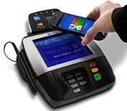
NFC Devices
Example: contactless payment applications
Sony FeliCa, Asia MIFARE, Europe Google Wallet
Modes of operation
Smart Card emulation (ISO 14443):
» Phone can act as a contactless credit card
» Information can be generated rather than pre-stored
Reader mode
» Allows NFC devices to access data from an object with an embedded RFID tag
» Enables the user to initiate data services, i.e., retrieval of rich content, advertisements, ..
Peer-to-peer (ISO 18092)
» Allows two way communication between NFC devices
» NFC can act as smart tag, i.e., generates information
(c) Google

Slide 33
Active and Passive Communication Modes
Passive communication: one device acts as a reader and the other as a tag
» Reader generates a field while the other responds
» The second device can be a tag or another NFC device
Active communication: both devices alternatively act as readers
» Allows fairly general two way communication
» Both devices must have a battery
Since NFC devices can read and write, they must check for collisions
» Compare received signal with transmitted signal

Slide 34
Outline
RFIDs
» Concept and applications
» EPC and backend processing
» PHY and MAC
» Security
Near Field Communication
Battery-less devices

Slide 35
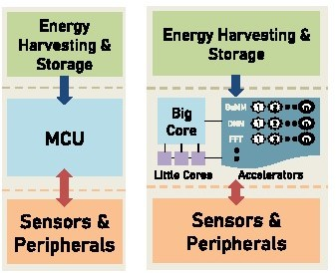
What is Next: Battery-less Devices
Devices rely entirely on energy harvesting
» Solar, RF, …
Battery can store limited amount of power
» Can be used when harvesting is slow or not possible
Different architectures are being explored
Goal is to have fairly general architectures
From: A Power-Aware Heterogeneous Architecture Scaling Model for Energy-Harvesting Computers, Desai, Lucia, IEEE Computer Architecture Letters, https://ieeexplore.ieee.org/document/9078058

Slide 36
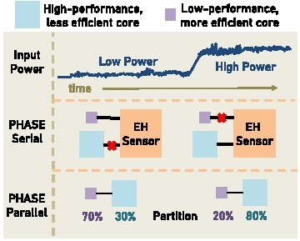
Example Design
Adapt level of activity to the available power
For example, use simple but efficient cores when power levels are low
Power hungry operations may have to wait
» E.g., send data

